Slide 1
World University Ranking Systems
Aman Geetey
Pranav Jaipurkar

Slide 2
Exploratory Data Analysis
The process of the preliminary investigation on our dataset to discover and spot certain anomalies, or patterns that might co in handy afterwards in our actual data analysis.
The relevance of such patterns cannot be ascertained beforehand, hence it is a good practice to retain most of them and build a hypothesis which corroborates most of them.

Slide 3
Description of the Dataset CWUR
The cwur dataset has a total of 2200 observations of 17 variables.
The variables represent separate features which display the quality of education, the total no. of citations, patents etc. for a university calculated and compiled for a certain year.
The cwur dataset contains universities from 59 countries.
Maximum number of universities are located in either US, UK and Spain with maximum being in the US(573),then UK(144), Spain(81).
The data was compiled from 2012 to 2015

Slide 4
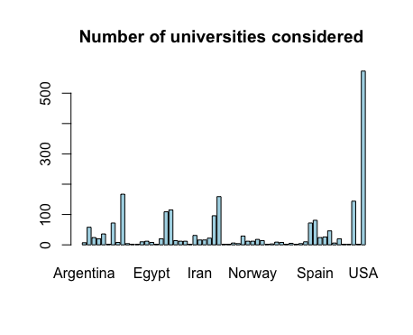

Slide 5
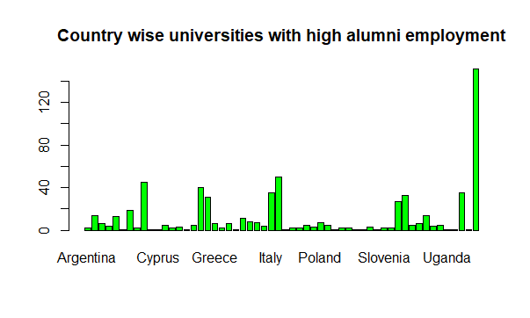

Slide 6
Times Dataset
Has a ranking system which ranks universities uptill the rank of 600.
Specific ranking is given till 200, range of universities given afterwards(200-250,250-300, and so on).
Data compiled from 2011-2016.
The data has 2603 observations and 14 variables.
The main feature difference with the CWUR dataset is student to staff ratio, income of the university.

Slide 7
Shanghai Dataset
The data has a lot of NA values, rendering most of the dataset unusable.
Similar to that of the Times ranking system, specific rankings are provided till 100, range specified then on.
Has a wide range in the year [2005 -2015].

Slide 8
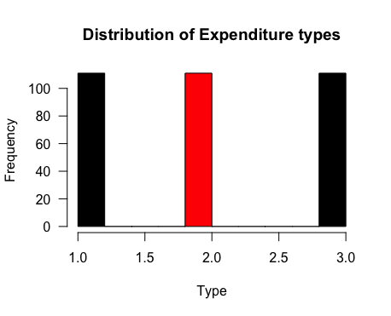

Slide 9
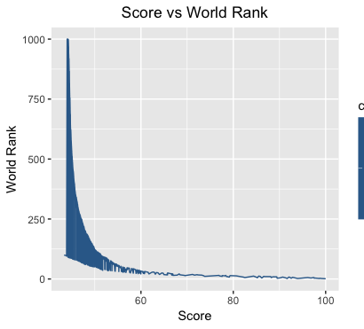
Ranking system has an inverse relation with the score used for deciding the rank.
The relation is initially linear and then goes on to be exponential.

Slide 10
“stringr” Package
Used for shortening of string length .
University to Univ.
Massachusetts Institute of Technology to MIT.
California to Cal.
Michigan to Mich.

Slide 11
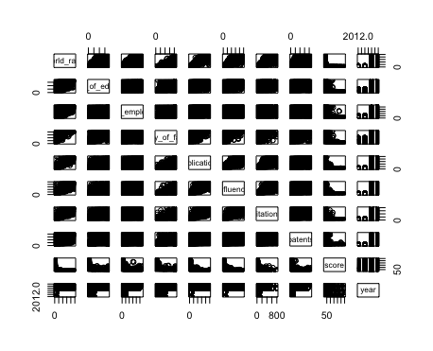
Correlation Pairs

Slide 12
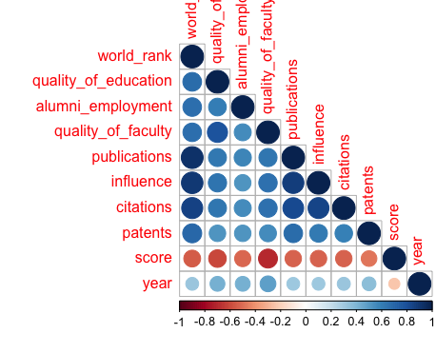
Correlation Plots
Pearson

Slide 13
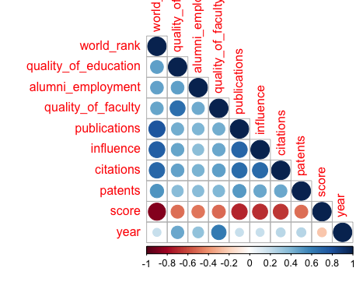
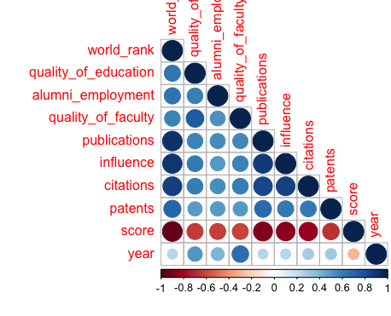
Correlation Plots Continued..
Spearman
Kendall

Slide 14
Linear Regression Model
Research based Model
Publications, influence, citations, patents
All features had high significance
Employment based model
Alumni Employment,
Quality of Education
Both were very significant
Both the model were inaccurate in predicting the rank.

Slide 15
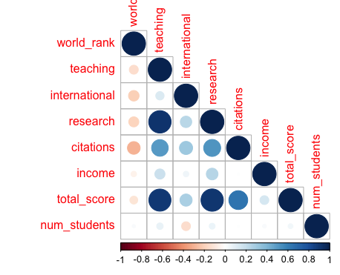
Correlation plot made from times dataset.
Covering only the universities located in the US.

Slide 16
Logistic Regression Models
A total of 4 models
Employment based (2)
Quality of education, alumni employment, quality of faculty, score
Research Based (2)
publications, citations, influence and patents.
Accuracy | Employment Based | Research Based
Complete Dataset | 91% | 92.5%
Subsetted Dataset | 92.5% (2015) | 94.5% (2014)

Slide 17
USA Centric Model
Same methodology followed. Used both research-based and employment- based categorization.
Dimension of the dataset was 229 observations and 14 variables.
Results | Research Based | Employment Based
2015 | 82.8% | 84.375%
2014 | 87.5% | 84.375%

Slide 18
Model for Times
In total 3 models made based on logistic regression.
Independent variables Research based :- Teaching, international income, no. of students, students to staff ratio.
Independent variables Employment based :- citations, total score.
Model | Accuracy
Research | 67.65%
Employment | 70.19%
Both | 72.81%

Slide 19
Models for Shanghai
Single model was made based on logistic regression.
Independent variables used :- Total score, alumni, hici, ns, pub, pcb.
Accuracy 45%

Slide 20
Research Ranking
Most ranking systems favor alumni employment and other factors (sometime geographical) over other qualitative features of an institution, like the total research output
We tried to create a separate ranking system based purely on the quality of research done by any university
This classification encompasses all the requirements pertaining specifically to research and can be helpful to someone focusing only on the research aspect when considering higher education

Slide 21
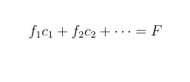
Feature definition
A new feature, which represented the consolidated research output was generated.
This represented the weighted sum of various other features included in the dataset, these weights can be representative of the level of importance given to certain features.
This can be summarized by the equation below

Slide 22
Hypothesis Testing
Creation of levels
Try different models
Check Accuracy
Given a binary classification problem, can we predict probable features used in generating the basis (of classification)

Slide 23
Setup for Classification
We used SVM for training our models
Different models were trained which had distinct combination of features, and the accuracy for each model was checked.
For the training of each model, repeated cross validation was used with the SVM model for better results.

Slide 24
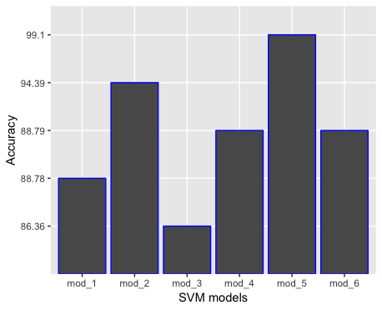
Different SVM models with all the features bearing some relation to research score.
Accuracy is mostly constant (around 86 to 88 percent).
The Accuracy jumps to 99% with the most relevant features.

